Slide 1
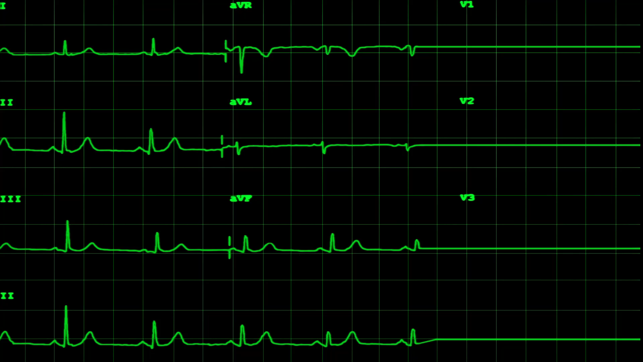
MACHINE-LEARNING AUDIO SURVEILLANCE INTEGRATED SYSTEM (MALASIS)
10 February 2022
Jacob Attia, Zachary Tauscher, Caleb Leeb, Jaclyn Welch, and Jorge Garcia

Slide 2
Overview
Reintroduction of MALASIS
Status at the end of Fall 2021
Progress on Audio Processing
Progress on Visualization Software
Progress on Hardware Casing/Setup
Progress on Sound Localization
Completion by Sprint 2
Next Steps

Slide 3
Reintroduction of MALASIS
Audio Surveillance System
Uses time-delay of arrival to localize sound sources
Turns DOA into telemetry
Classifies sound sources
Categorizes them into sections like: “voices,” “footsteps,” “crashes,”
Plots sounds onto a map that indicates their positions in the room
Tracks multiple persistent sound sources (such as two people talking)

Slide 4
Status at the End of Fall 2021
Audio Processing
Creates spectrograms of sounds in .wav files
Able to run in real time with bursts for input
Sound Localization
Figured out how to obtain TDOA values
Creation of localization sub-system in progress
Visualization Software
Displays radial position of object
Outputs specific angles in degrees from North

Slide 5
Progress on Audio Classification
Added additional pre-processing steps
Implemented a full CNN
Added validation and loss analysis
Full model implemented with sample data
Sample data: 9 different voice commands
Goal: 3+ surveillance-related sounds

Slide 6
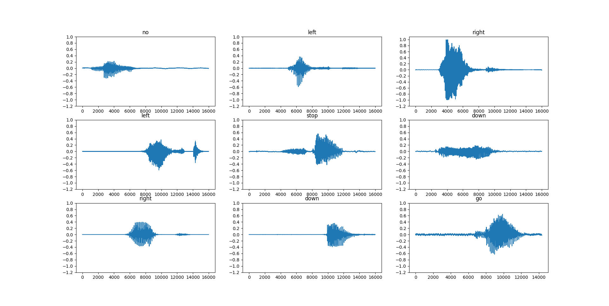

Slide 7
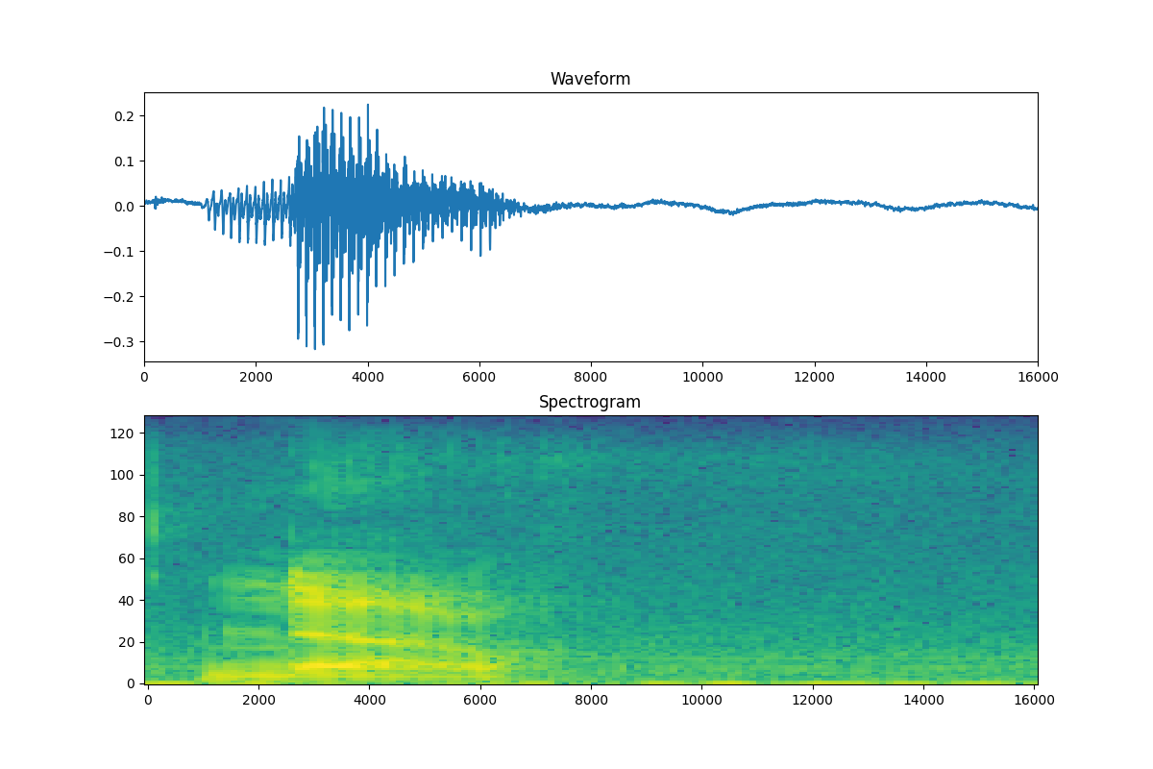

Slide 8
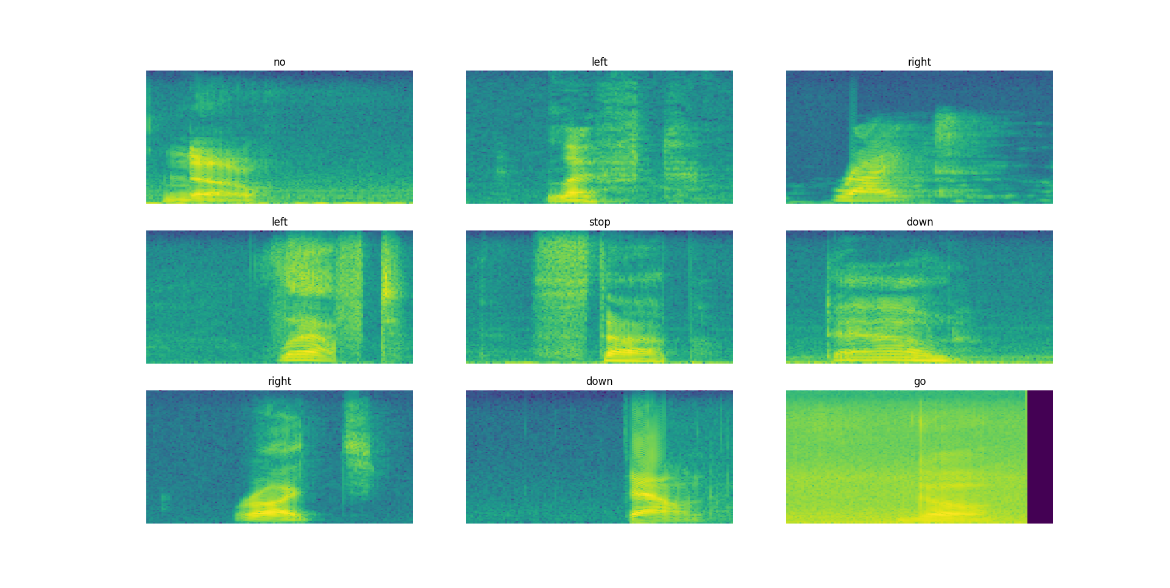

Slide 9
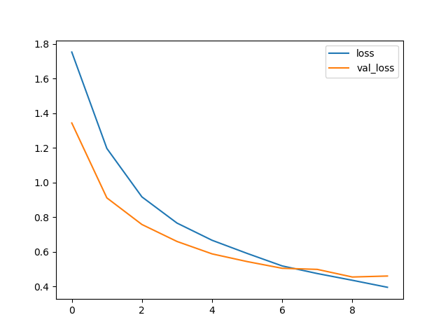

Slide 10
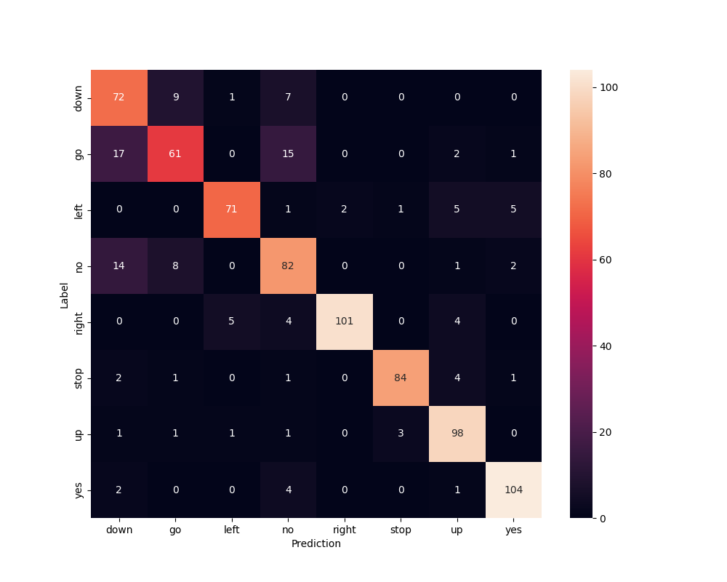

Slide 11
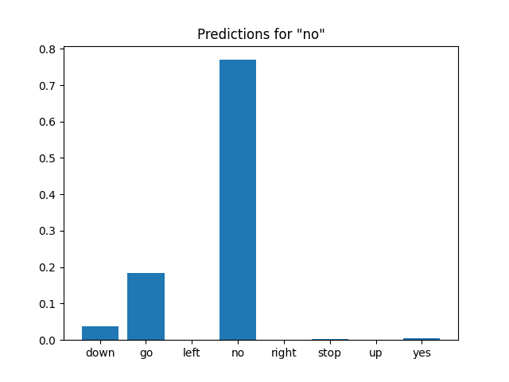

Slide 12


Slide 13
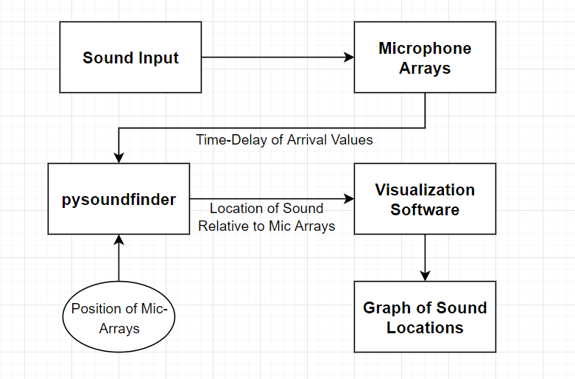
Progress on Sound Localization

Slide 14
Progress on Sound Localization
Pysoundfinder
https://github.com/rhine3/pysoundfinder
Sound localization software
Takes 3 inputs
Recorder positions
Time delay of arrival for recorders
Ambient temperature
Returns plot indicating the location of the sound relative to the microphones

Slide 15
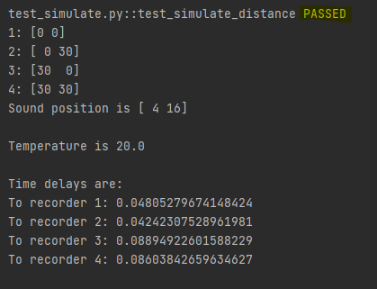

Slide 16
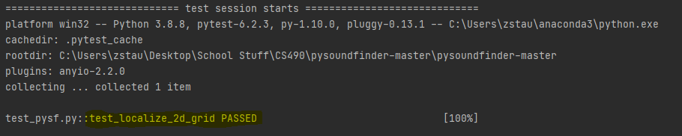
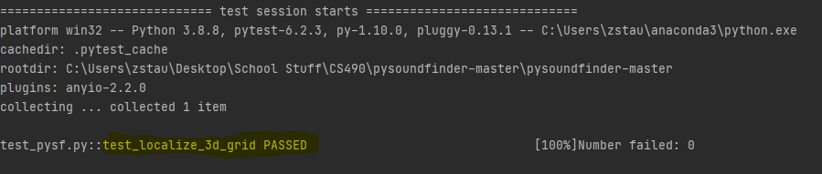

Slide 17
Progress on Visualization Software
Complete with labels
Updates every tick
Position
Label
Currently reads in real-time

Slide 18
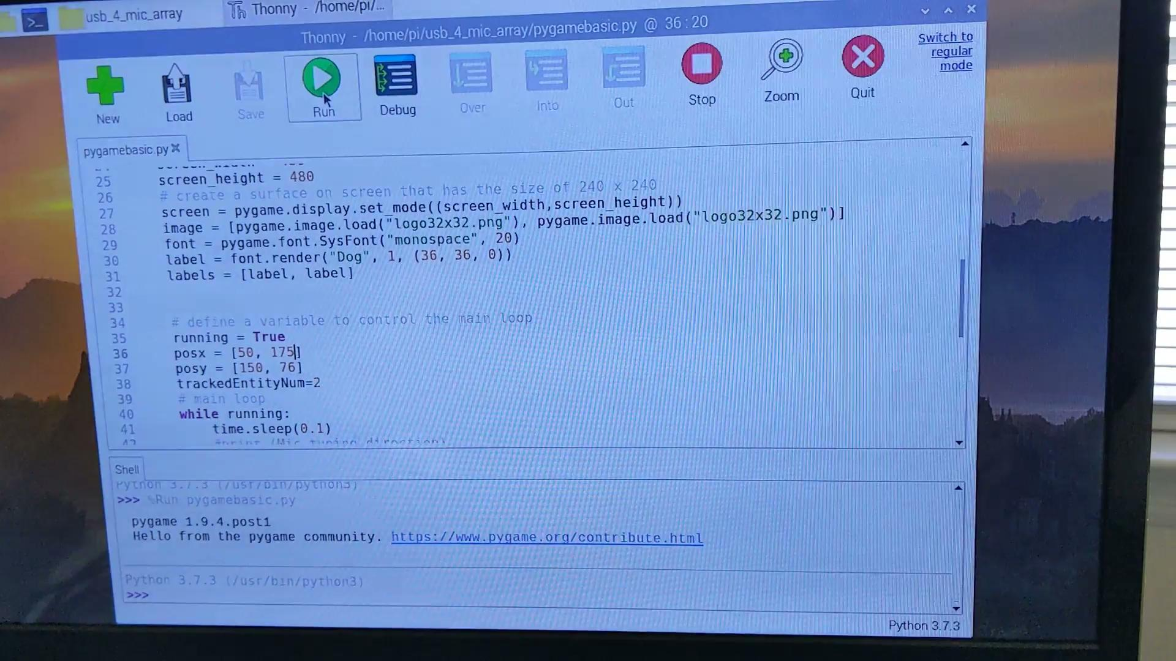

Slide 19
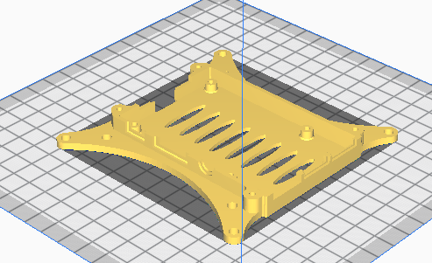
Progress on Casing/Setup

Slide 20
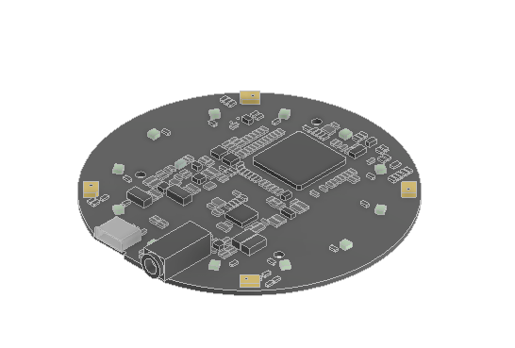
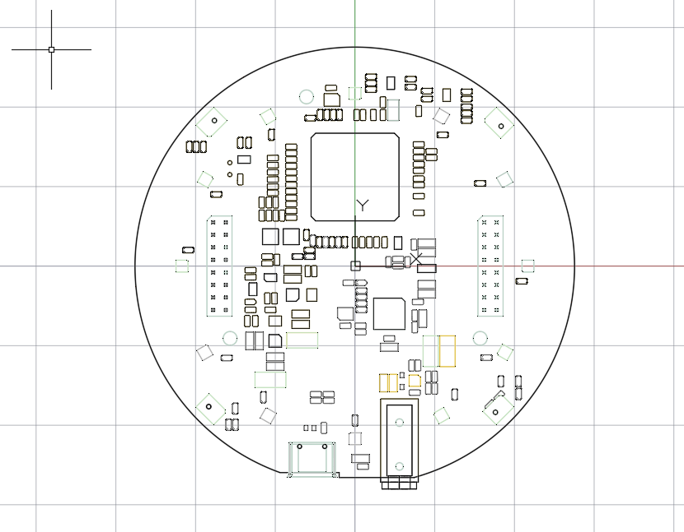
Progress on Casing/Setup

Slide 21
What is Next?
Classification
Training data, train the model with it
Real time input
Sound Localization
Testing phase with real TDOA values
Visualization Software
Complete
Hardware Casing & Setup
Finalize mounting on case for microphone array

Slide 22
Thank you!
Questions?

